Slide 1
Инфраструктурни решения за контейнеризация

Slide 2

Virtualization

Slide 3
What is Virtualization?
VM 1
VM 2
VM 3
"In computing, virtualization refers to the act of creating a virtual (rather than actual) version of something, including virtual computer hardware platforms, operating systems, storage devices, and computer resources". - According to Wikipedia
App
App
App
Bins Libs
Bins Libs
Bins Libs
Guest OS
Guest OS
Guest OS
Hypervisor
Operating System
Hypervisor
Host OS

Slide 4
Hypervisor or VMM
Hypervisor Type 1
(native or bare-metal)
KVM
AWS Nitro
IBM z/VM
Microsoft Hyper-V
Nutanix AHV
Oracle VM Server for SPARC
Red Hat Virtualization
VMware ESXi
Xen.
Hypervisor Type 2
(hosted)
VirtualBox
VMware Player & Workstation
Parallels Desktop for Mac
KVM*

Slide 5
Advantages of Virtualization
Node-0
Node-1
Resource Utilization
Security Isolation
Disaster Recovery
Scalability
Portability

Slide 6
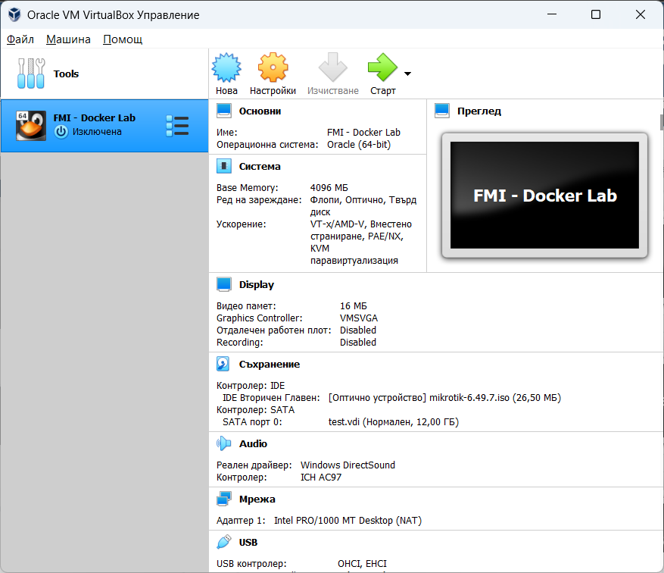
VirtualBox
It is an open source solution.
It is free & easy to use.
It runs on Cross-platforms.
It support software-based virtualization and hardware-assisted virtualization.
It allows virtual machines to be easily exported and imported

Slide 7
Virtual Box
Setting up the environment
VirtualBox Download https://www.virtualbox.org/wiki/Downloads
Debian https://www.debian.org/distrib/

Slide 8

Thank You!

